Slide 1



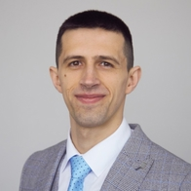
WHO: Team AsyncAwaitAdventurers
Kiryl Bahdanets
Dzmitry Shaplyka
Alexandr Legchilov
TA engineers who believe testing should be driven by intent, not boilerplate.

Slide 2
WHAT: The Problem and Our Solution
QA teams hit the same three-stage bottleneck: writing test cases, hand-coding, and maintaining it all.
We built Dark Factory — a framework that collapses this into one prompt.
Tech stack: Claude Code, Playwright, Playwright CLI
Why Claude Code? Three native capabilities no other tool offered:
Multi-agent delegation — four agents defined in markdown, no external framework
PostToolUse hooks — reactive automation triggered by file writes
Skills — domain-specific tools scoped to each agent

Slide 3
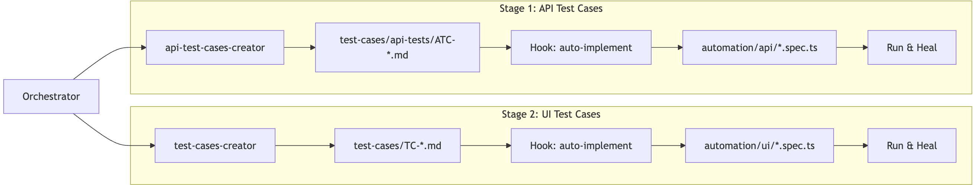
WHAT: Architecture
Four agents: Orchestrator delegates to three specialists; Test Cases Creator for UI, API Test Cases Creator for endpoints, and Playwright Healer for self-fixing failures.
Three skills: API Schema Reader minimizes a 41,000-line OpenAPI spec to 20 lines of context instead of 200. Playwright CLI drives browser automation. Playwright Healer enforces a 5-attempt fix cycle with mandatory escalation.
One hook closes the loop — writing a test case automatically triggers spec generation, execution, and healing. No manual steps.
The flow: Classify the request, extract the schema, generate test cases, implement the spec, heal failures.
One prompt in. Twenty passing tests out.

Slide 4
WHY: Results and Benefits
141 test cases | 39 automated specs | 4 agents | 1 hook | 0 lines written by a human
Speed — days of QA work done in minutes
Accuracy — test cases generated from the actual API spec, not outdated docs
Self-healing — broken tests get fixed automatically, or escalated with full context
Target-agnostic — swap the API spec and context, test any REST API
Zero overhead — no LangChain, no glue code, just markdown definitions and Claude Code's runtime
QA has always been a downstream bottleneck. Dark Factory turns it into a prompt.
*AsyncAwaitAdventurers — Built with Claude Code, 2026 AI Hackathon*

